Slide 1
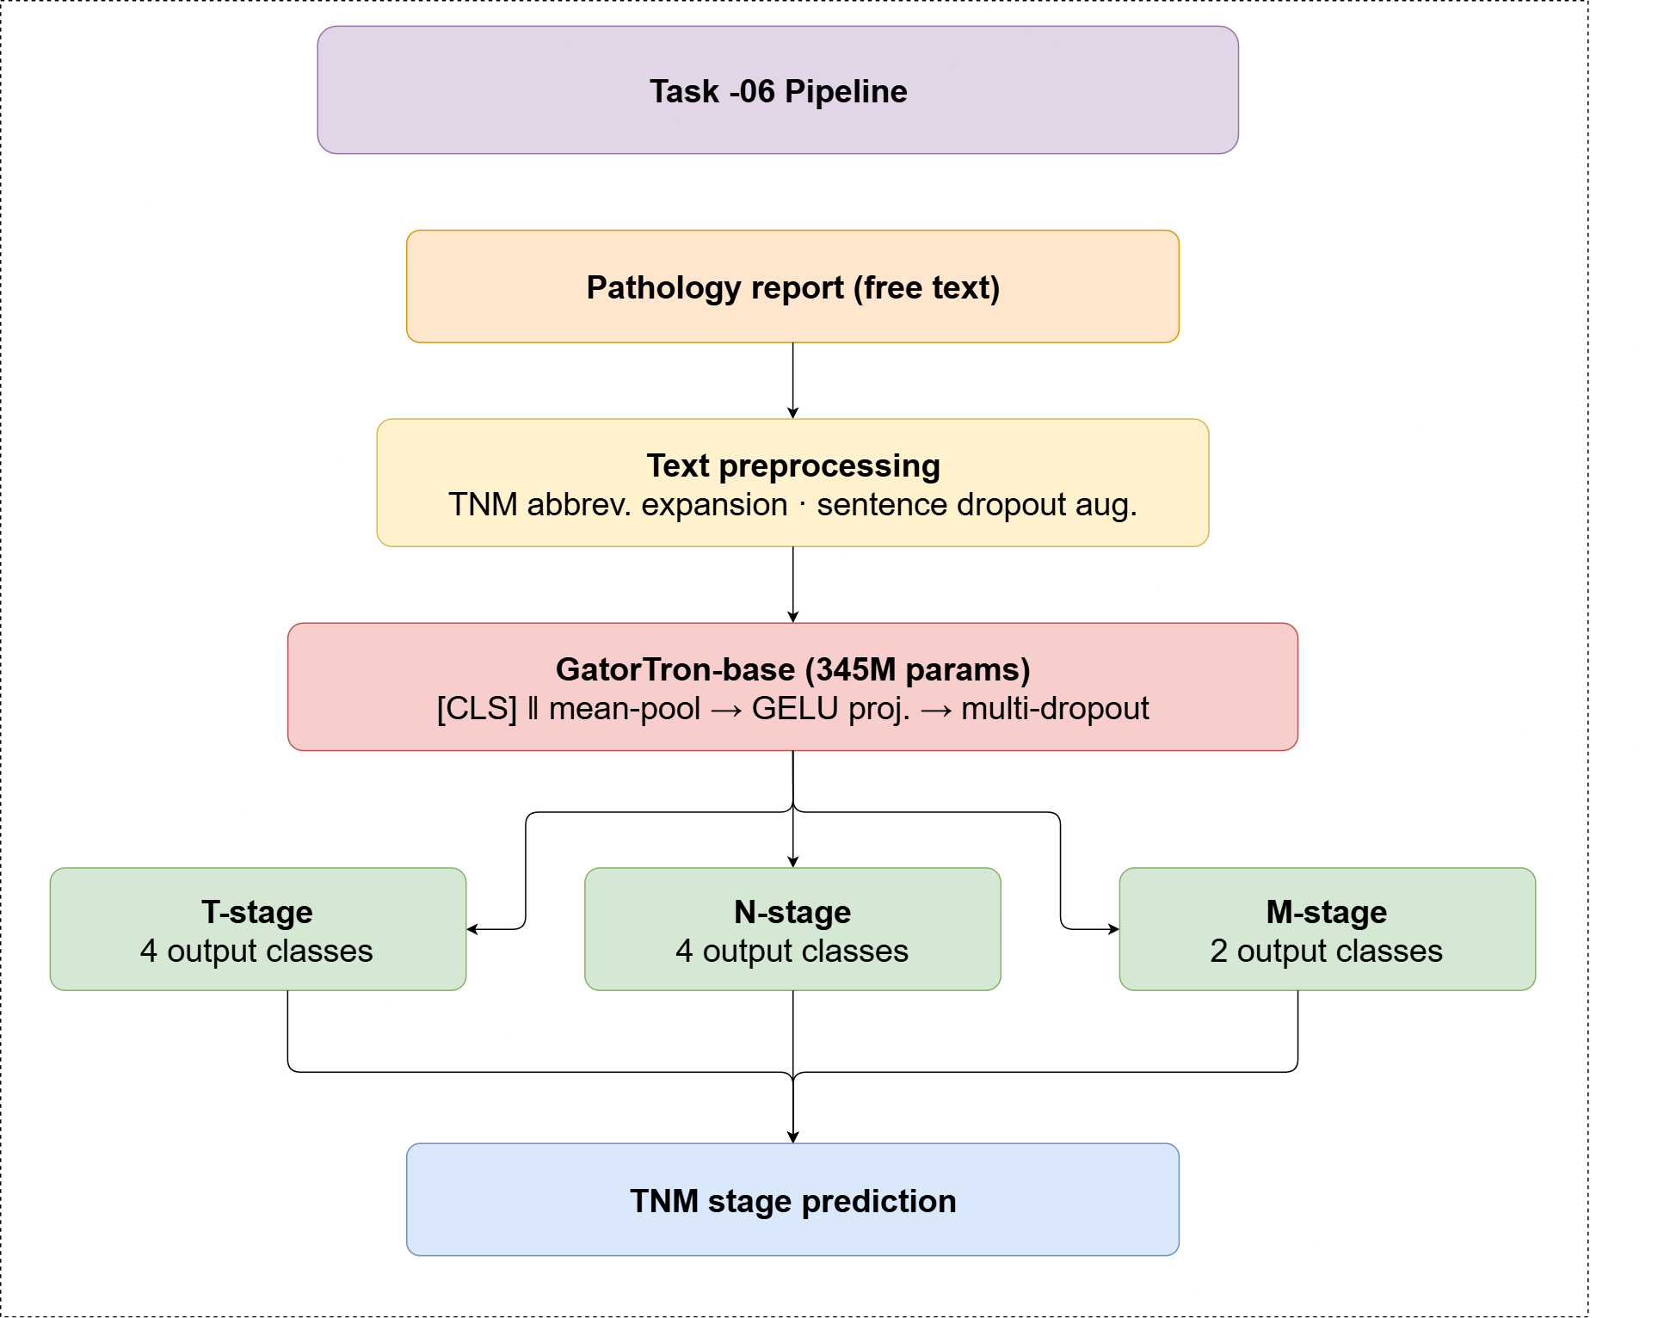
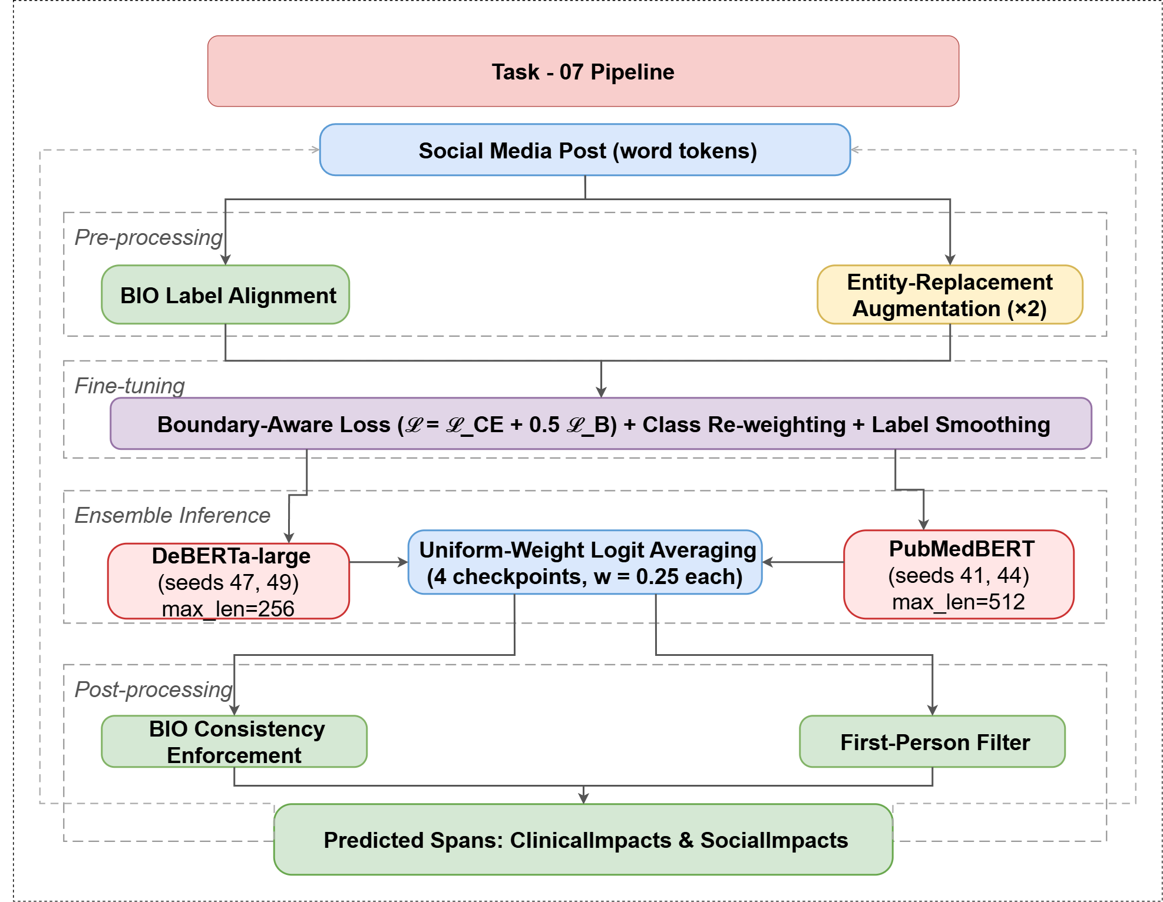
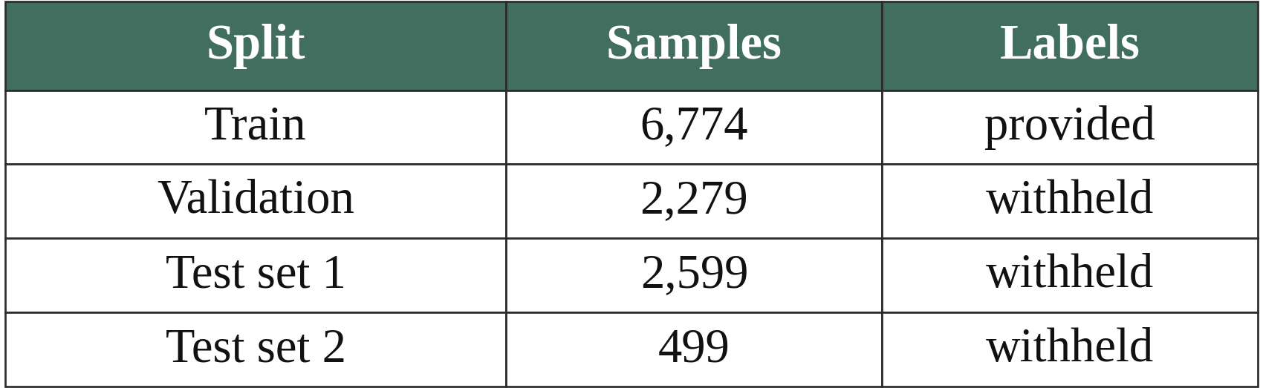
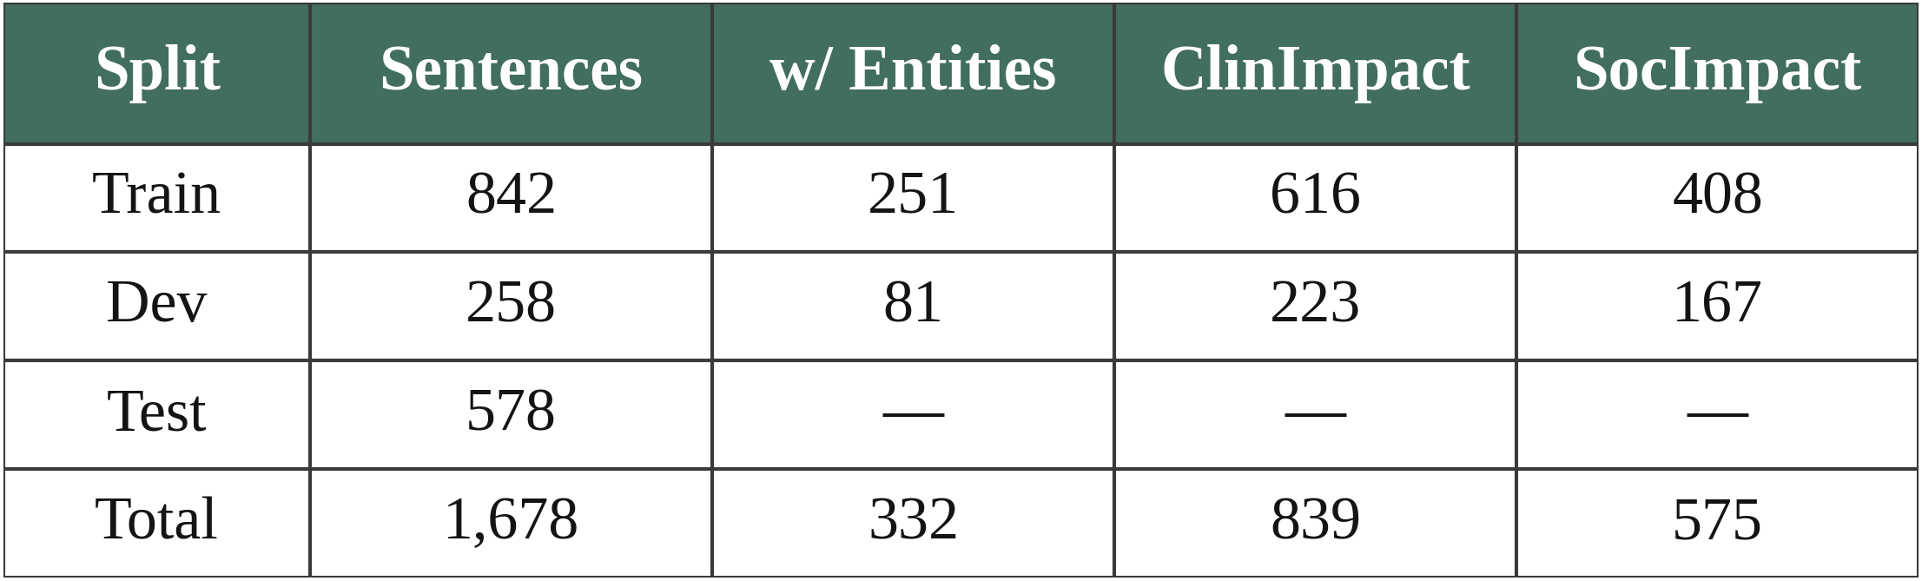
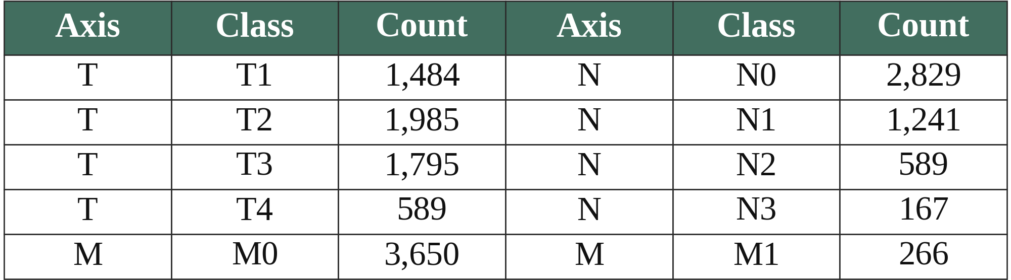
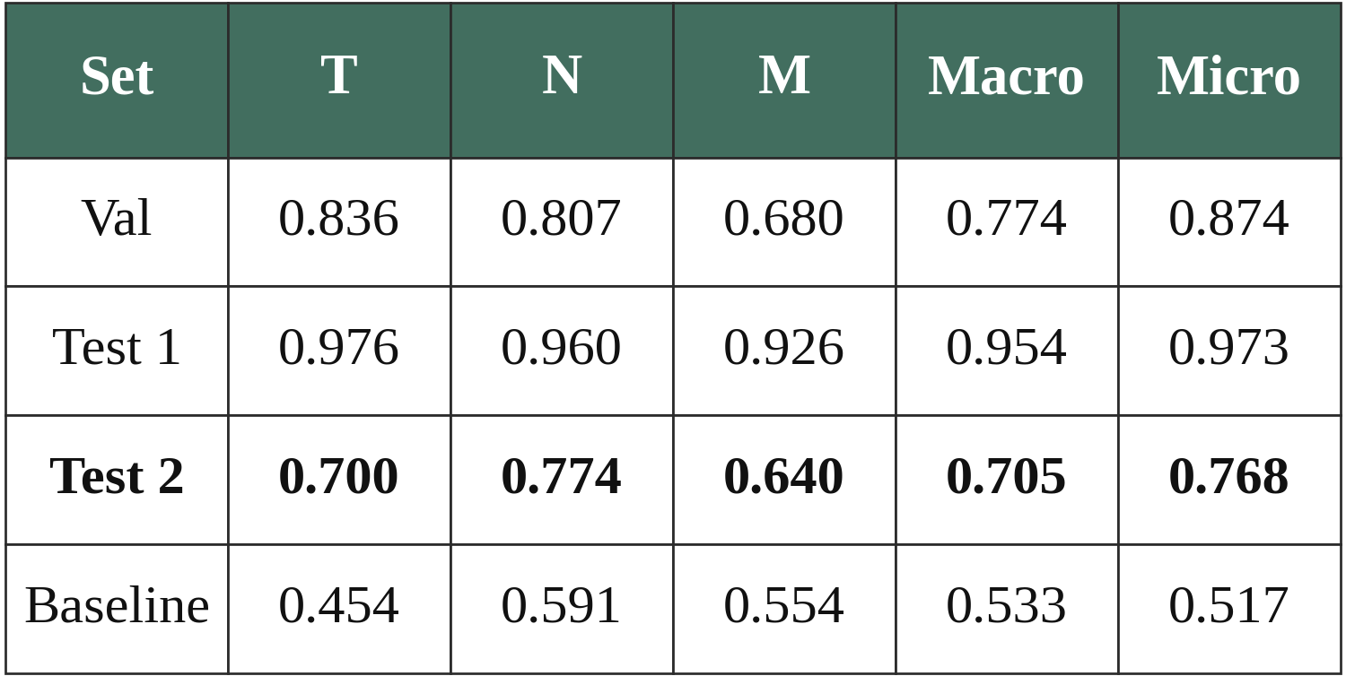
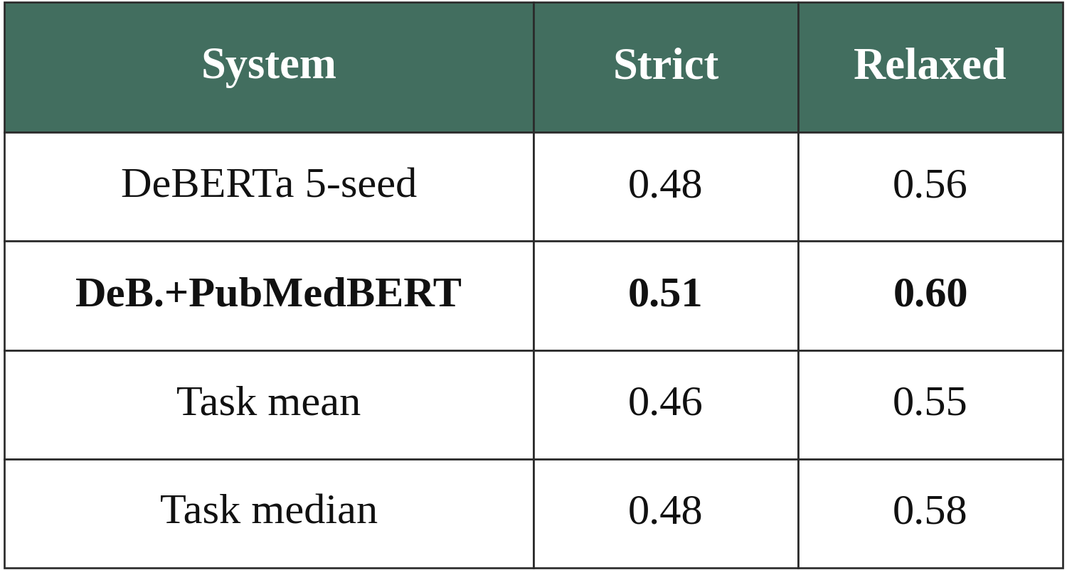
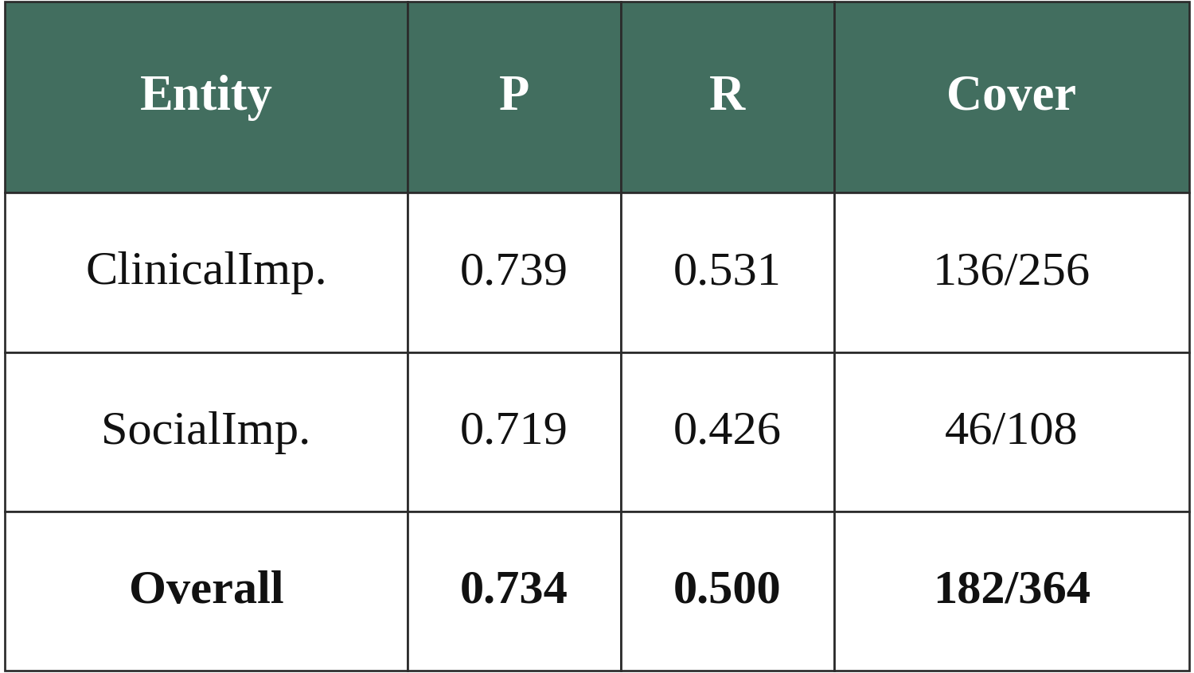
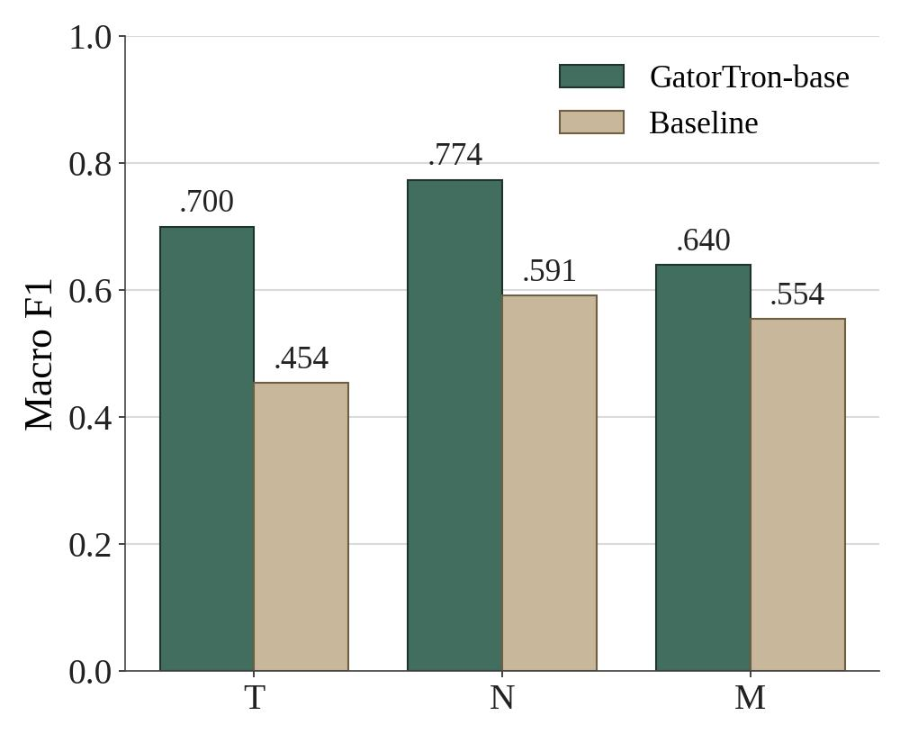
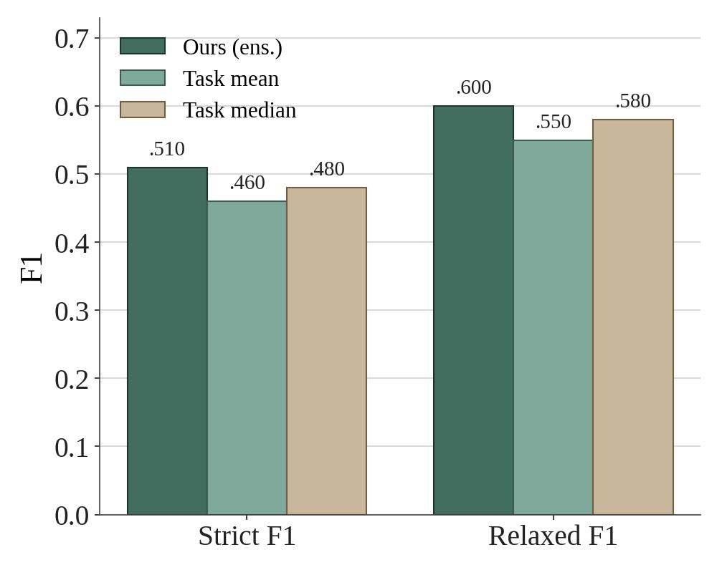
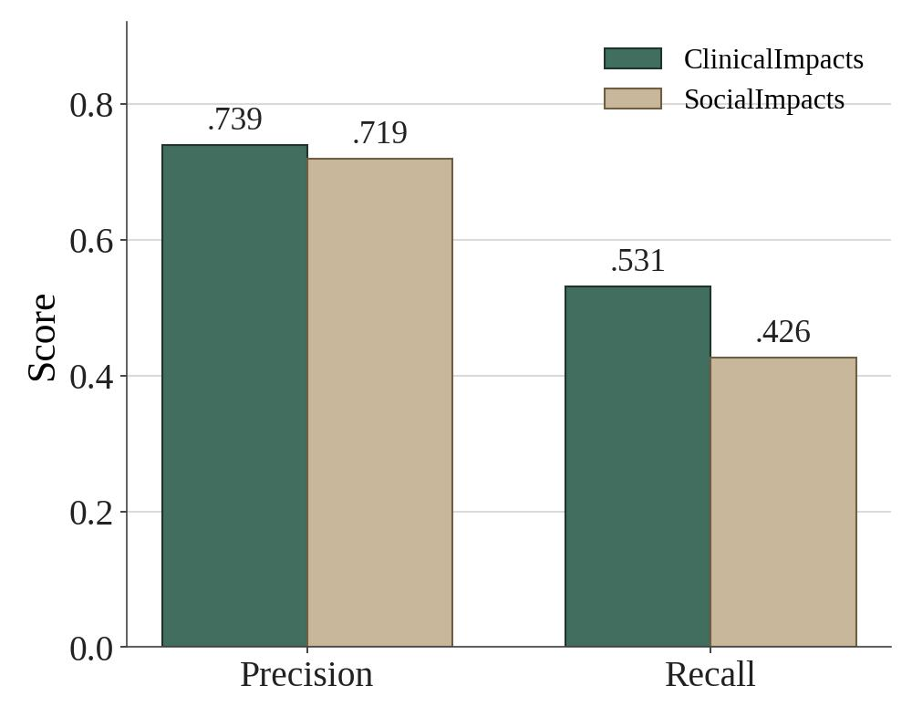
CUET_DiagNLP at #SMM4H-HeaRD 2026: Per-Axis TNM Staging from Pathology Reports and Opioid Impact Span Detection from Social Media
Shuva Dey, Priyangshu Barua, Dr. A. H. M. Ashfak Habib
Department of Computer Science and Engineering
Chittagong University of Engineering and Technology, Bangladesh
{u2104001, u2104033}@student.cuet.ac.bd, ashfak@cuet.ac.bd
Objectives
Main Contribution
Methodology
Tackle two #SMM4H-HeaRD 2026 tasks that extract health signals from unstructured text.
Task 6: per-axis TNM staging (T, N, M) from free-text TCGA pathology reports.
Task 7: opioid ClinicalImpacts / SocialImpacts span detection in Reddit posts.
Two domain-adapted transformer systems with task-specific loss design: GatorTron-base trained per TNM axis (Task 6) and a boundary-aware DeBERTa-large + PubMedBERT ensemble (Task 7).
GatorTron-base (345M) is fine-tuned per TNM axis with a [CLS]–mean-pool GELU head and multi-dropout. TNM abbreviations are expanded (pT2 → pathologic tumor T2), and training uses Focal Loss (γ=2) with per-class weights and AdamW.
Dataset Analysis
Task 6 uses free-text TCGA pathology reports on three axes — T (T1–T4), N (N0–N3), M (M0–M1) — with heavy missingness; M1 is just 266 of 3,916 samples. Task 7 uses first-person Reddit posts with five BIO labels; SocialImpacts = 575/1,414 tokens (40.7%).
Introduction
The #SMM4H-HeaRD 2026 tasks span biomedical NLP, clinical text mining, and social-media health surveillance, where key signals sit in unstructured text.
TNM stage is locked inside variable-length TCGA reports (M1 < 7% of samples), while opioid consequences appear informally on social media with sharp class imbalance.
Table 1: Task 6 dataset splits.
Table 3: Task 7 dataset statistics.
Pathology reports often exceed 512 tokens with severe label skew, needing long-document encoders.
Clinical NER transfers poorly to social media due to informal text and fuzzy span boundaries.
Figure 1: System pipeline for Task 6 (left) and Task 7 (right).
Table 2: Task 6 training label distribution per TNM axis (T, N, M).
Task 7 — DeBERTa-large + PubMedBERT (two seeds each) are fine-tuned for token classification and combined by uniform-weight logit averaging.
Boundary-aware loss L = L_CE + (λ−1)L_B (λ=1.5) penalizes span-start misses; SocialImpacts weights ×1.35.
Entity-replacement augmentation swaps spans with curated synonyms (23 clinical, 20 social), +~30% data.
A first-person filter (i, i'm, my, me, myself, we, our) forces all-O on third-person posts.
BIO consistency post-processing cleans the predicted spans.
Results
Task 6: TNM Staging
Task 7: Span Detection
Task 7: Per-Entity Analysis
Conclusion
Table 6: Task 6 macro / micro-F1 by TNM axis and evaluation set.
Table 7: Task 7 strict / relaxed F1 vs. task mean and median.
Table 8: Per-entity precision, recall, and span coverage.
Task-specific loss design and data augmentation proved highly effective for both tasks.
Task 6: Focal Loss and class weights help, but M1 scarcity remains the main challenge.
Task 7: The DeBERTa + PubMedBERT ensemble outperforms DeBERTa alone; long SocialImpacts spans remain difficult.
Future work includes span-level objectives for Task 7 and semi-supervised learning for Task 6.
Table 6: GatorTron-base reaches macro-F1 0.774 on validation and 0.954 on test set 1. On the hard test set 2 it scores 0.705, beating the baseline (0.533) by 0.172. M-stage trails T and N due to M1 scarcity.
Table 7: the DeBERTa + PubMedBERT ensemble reaches strict F1 0.51 and relaxed F1 0.60 on test, above the task mean (0.46 / 0.55) and median (0.48 / 0.58). Gains over DeBERTa-only are precision-driven.
Table 8: ClinicalImpacts precision (0.739) exceeds SocialImpacts (0.719); overall P 0.734 / R 0.500 over 182/364 spans. PubMedBERT trades social recall for clinical precision.
Figure 2: Task 6 macro-F1 by axis — ours vs. baseline.
Figure 3: Task 7 strict / relaxed F1 across systems.
Figure 4: Precision and recall by entity type.

